Slide 1
Point-to-point Communication
Lecture 4
Jan 17, 2023

Slide 2
MPI Program Execution
Memory
host1
host2
host3
host4
Intranode
Internode
mpiexec –n 8 –hosts host1,host2,host3,host4 ./exe
Notes:
Implementation Notes: PMI_Init is called within MPI_Init or MPI_Init_thread, and should not make calls to MPI functions.
One exception is for the MPI error class and code functions. PMI_Init may use MPI_Add_error_class and MPI_Add_error_code.

Slide 3
MPI Program Execution
Memory
host1
host2
host3
host4
hostfile
cn023
cn024
cn025
cn026
cn023
cn024
cn025
cn026
Intranode
Internode
mpiexec –n 8 –f hostfile ./exe
Notes:
Implementation Notes: PMI_Init is called within MPI_Init or MPI_Init_thread, and should not make calls to MPI functions.
One exception is for the MPI error class and code functions. PMI_Init may use MPI_Add_error_class and MPI_Add_error_code.

Slide 4
MPI Reference Material
Marc Snir, Steve W. Otto, Steven Huss-Lederman, David W. Walker and Jack Dongarra, MPI - The Complete Reference, Second Edition, Volume 1, The MPI Core.
William Gropp, Ewing Lusk, Anthony Skjellum, Using MPI: portable parallel programming with the message-passing interface, 3rd Ed., Cambridge MIT Press, 2014.
https://www.mpi-forum.org/docs/mpi-4.1/mpi41-report.pdf

Slide 5
Point-to-point Communication
Blocking send and receive
MPI_Send
MPI_Recv
int MPI_Send (const void *buf, int count, MPI_Datatype datatype, int dest, int tag, MPI_Comm comm)
SENDER
Tags should match
int MPI_Recv (void *buf, int count, MPI_Datatype datatype, int source, int tag, MPI_Comm comm, MPI_Status *status)
RECEIVER

Slide 6
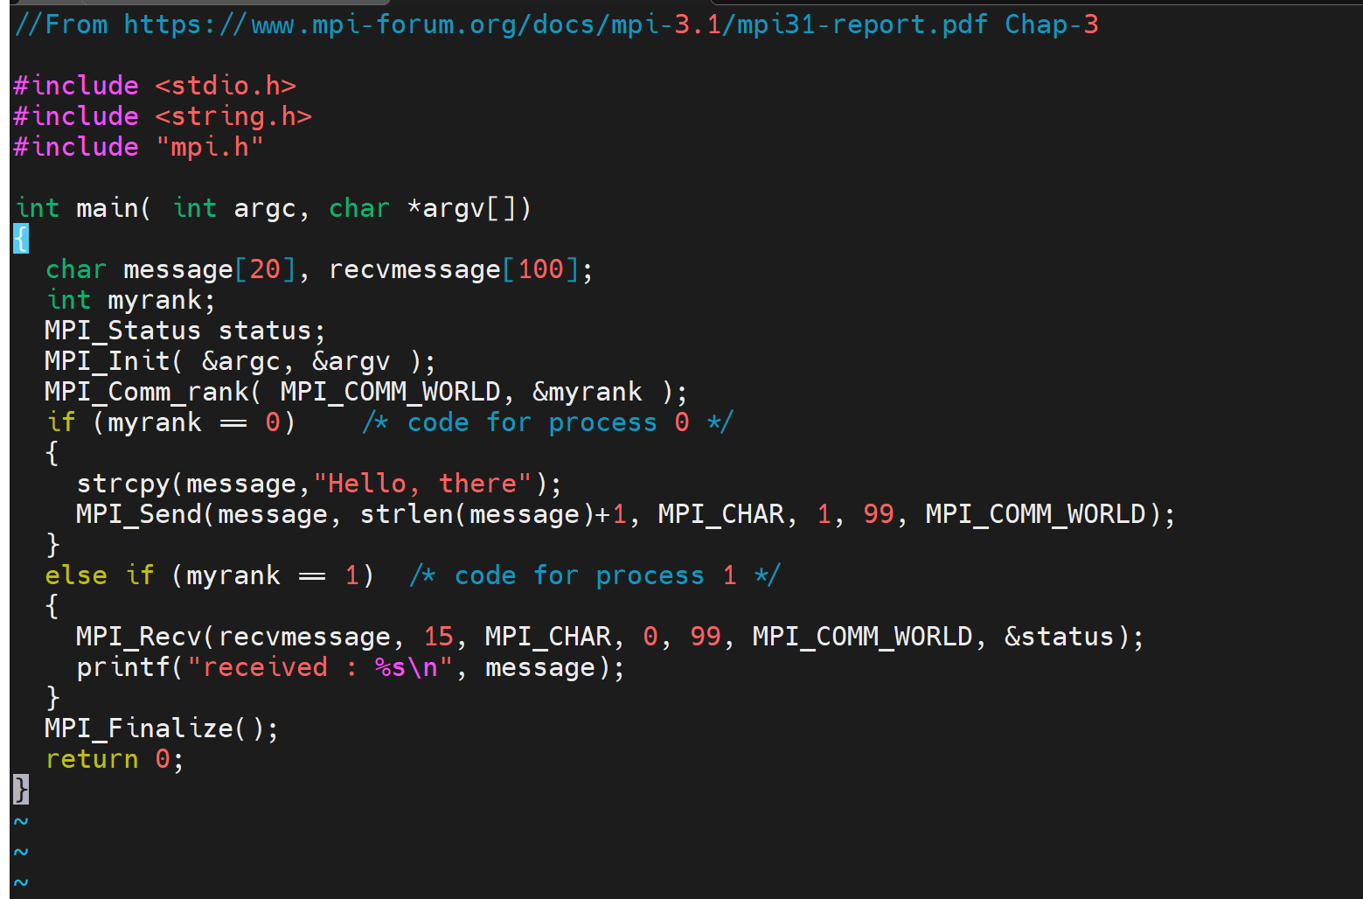
Simple Send/Recv Code (sendmessage.c)
No runtime or compile-time error

Slide 7
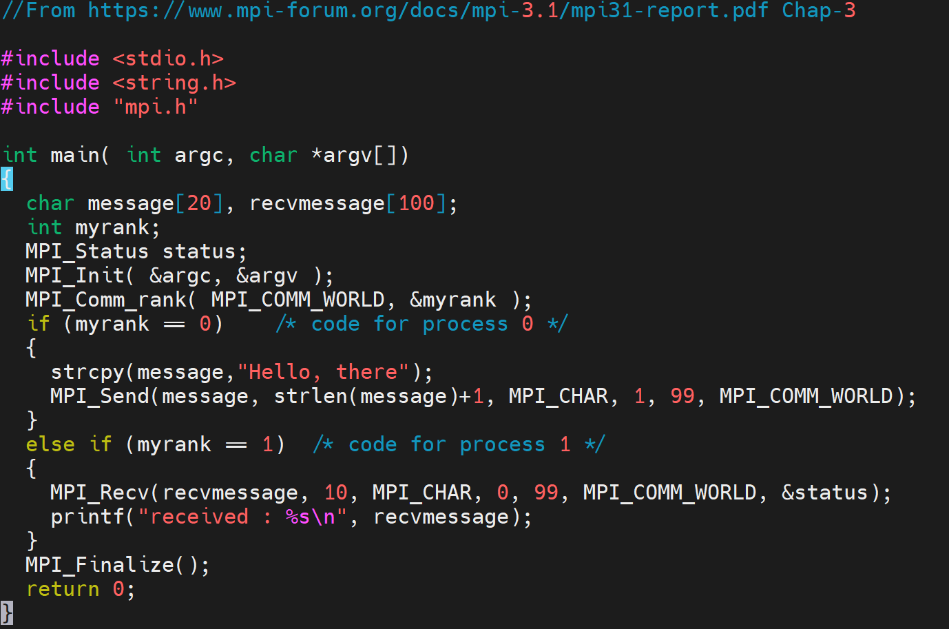
Runtime error

Slide 8
Message Size
Sender
message (13 bytes)
Receiver
Message (10 bytes)
Fatal error in MPI_Recv: Message truncated, error stack:
MPI_Recv(200)...........................: MPI_Recv(buf=0x7ffccc37c610, count=10, MPI_CHAR, src=0, tag=99, MPI_COMM_WORLD, status=0x7ffccc37c5d0) failed
MPIDI_CH3_PktHandler_EagerShortSend(363): Message from rank 0 and tag 99 truncated; 13 bytes received but buffer size is 10

Slide 9
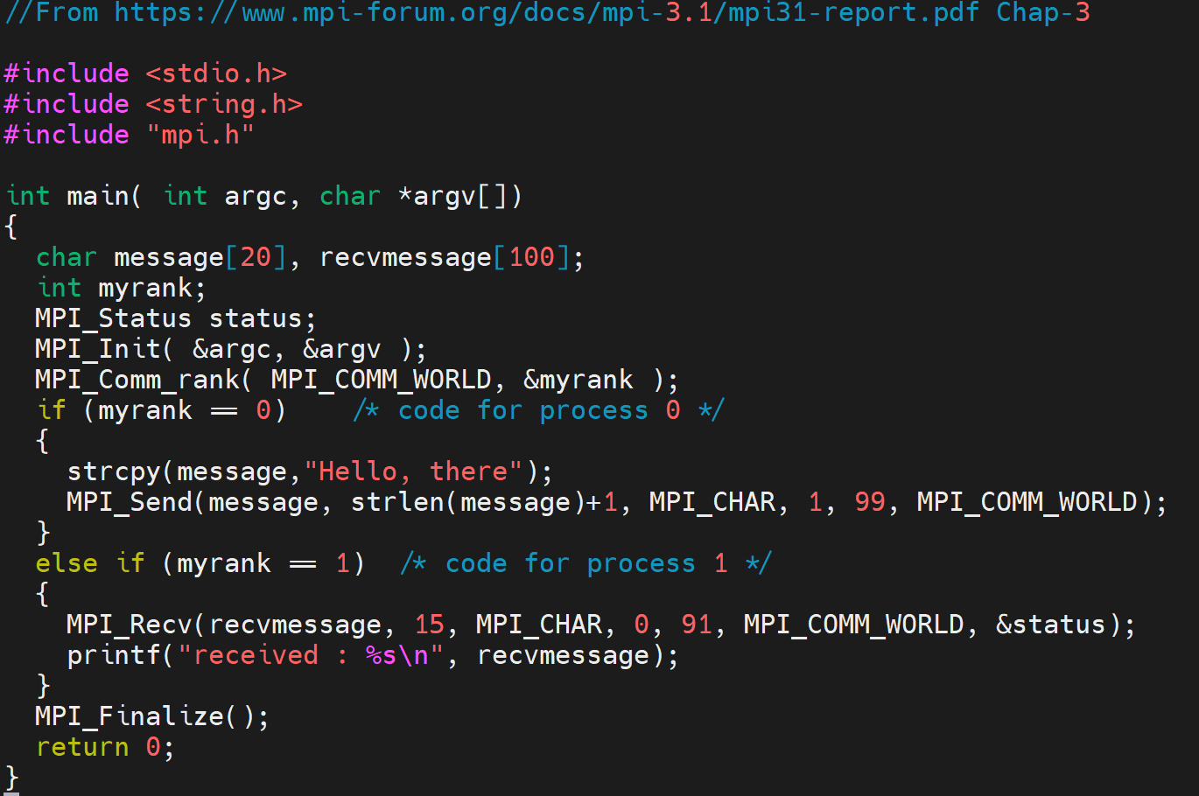
No runtime or compile-time error

Slide 10
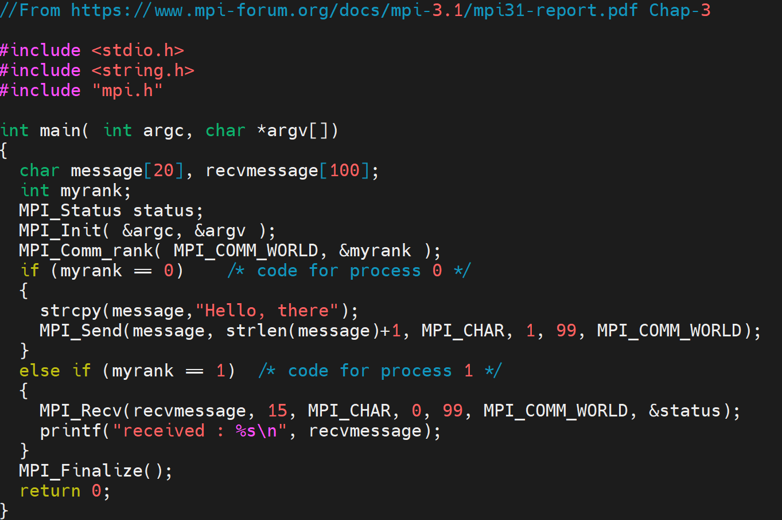
Simple Send/Recv Code (sendmessage.c)
received : Hello, there

Slide 11
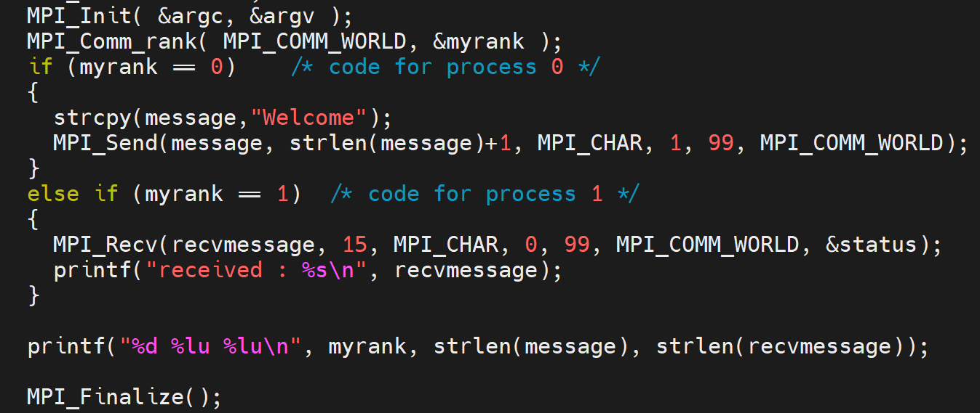
Output
0 7 0
Received: Welcome
1 0 7

Slide 12
Multiple Sends and Receives
if (myrank == 0)
MPI_Send (buf, count, MPI_INT, 1, 1, MPI_COMM_WORLD);
else
if (myrank == 1)
MPI_Recv (buf, count, MPI_INT, 0, 1, MPI_COMM_WORLD, &status);
printf ("%d %d\n", myrank, count);
$ mpirun –np 2 ./send 10
0 10
1 10

Slide 13
Multiple Sends and Receives
if (myrank == 0)
MPI_Send (buf, count, MPI_INT, 1, 1, MPI_COMM_WORLD),
MPI_Send (buf, count, MPI_INT, 1, 2, MPI_COMM_WORLD);
else
if (myrank == 1)
MPI_Recv (buf, count, MPI_INT, 0, 1, MPI_COMM_WORLD, &status),
MPI_Recv (buf, count, MPI_INT, 0, 2, MPI_COMM_WORLD, &status);
printf ("%d %d\n", myrank, count);
$ mpirun –np 2 ./send 10
0 10
1 10

Slide 14
Multiple Sends and Receives
if (myrank == 0)
MPI_Send (buf, count, MPI_INT, 1, 1, MPI_COMM_WORLD),
MPI_Send (buf, count, MPI_INT, 1, 2, MPI_COMM_WORLD);
else
if (myrank == 1)
MPI_Recv (buf, count, MPI_INT, 0, 1, MPI_COMM_WORLD, &status),
MPI_Recv (buf, count, MPI_INT, 0, 1, MPI_COMM_WORLD, &status);
printf ("%d %d\n", myrank, count);
$ mpirun –np 2 ./send 10
0 10

Slide 15
Multiple Sends and Receives
if (myrank == 0)
MPI_Send (buf, count, MPI_INT, 1, 1, MPI_COMM_WORLD),
MPI_Send (buf, count, MPI_INT, 1, 2, MPI_COMM_WORLD);
else
if (myrank == 1)
MPI_Recv (buf, count, MPI_INT, 0, 2, MPI_COMM_WORLD, &status),
MPI_Recv (buf, count, MPI_INT, 0, 1, MPI_COMM_WORLD, &status);
printf ("%d %d\n", myrank, count);
$ mpirun –np 2 ./send 10
0 10
1 10

Slide 16
MPI_Send (Blocking, Standard Mode)
Does not return until buffer can be reused
Message buffering can affect this
Implementation-dependent
SENDER
RECEIVER

Slide 17
Buffering
[Source: Cray presentation]

Slide 18
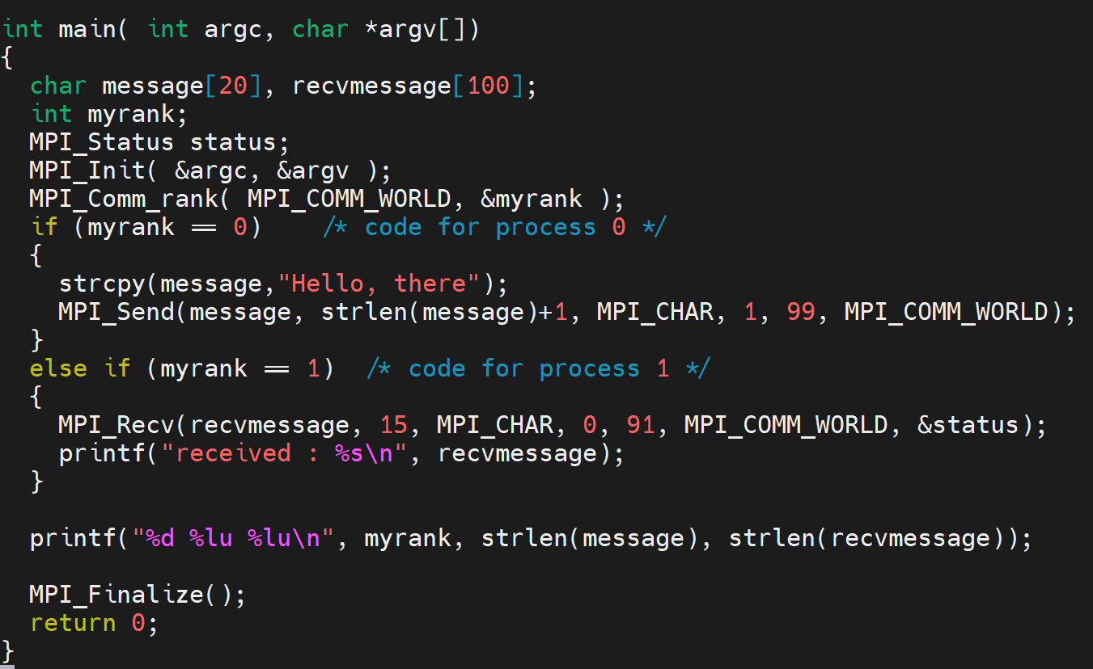
0 12 0

Slide 19
Multiple Sends and Receives
if (myrank == 0)
MPI_Send (buf, count, MPI_INT, 1, 1, MPI_COMM_WORLD),
MPI_Send (buf, count, MPI_INT, 1, 2, MPI_COMM_WORLD);
else
if (myrank == 1)
MPI_Recv (buf, count, MPI_INT, 0, 2, MPI_COMM_WORLD, &status),
MPI_Recv (buf, count, MPI_INT, 0, 1, MPI_COMM_WORLD, &status);
printf ("%d %d\n", myrank, count);
$ mpirun –np 2 ./send 1000000

Slide 20
Eager vs. Rendezvous Protocol
Eager
  Send completes without acknowledgement from destination
  MPIR_CVAR_CH3_EAGER_MAX_MSG_SIZE (check output of mpivars)
  Small messages, typically 128 KB (at least in MPICH)
    Not safe to use the send buffer if message size is small
Rendezvous
  Requires an acknowledgement from a matching receive
  Large messages

Slide 21
MPI_Status
int MPI_Recv (void *buf, int count, MPI_Datatype datatype, int source, int tag, MPI_Comm comm, MPI_Status *status)
Source rank
Message tag
Message length
  MPI_Get_count
typedef struct _MPI_Status {
int count;
int cancelled;
int MPI_SOURCE;
int MPI_TAG;
int MPI_ERROR;
} MPI_Status, *PMPI_Status;

Slide 22
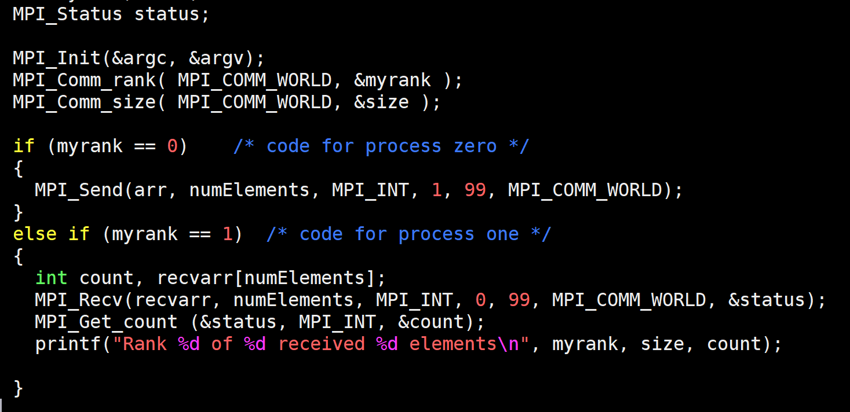
MPI_Get_count (status.c)
status.MPI_SOURCE
status.MPI_TAG
Output
Rank 1 of 2 received 1000 elements

Slide 23
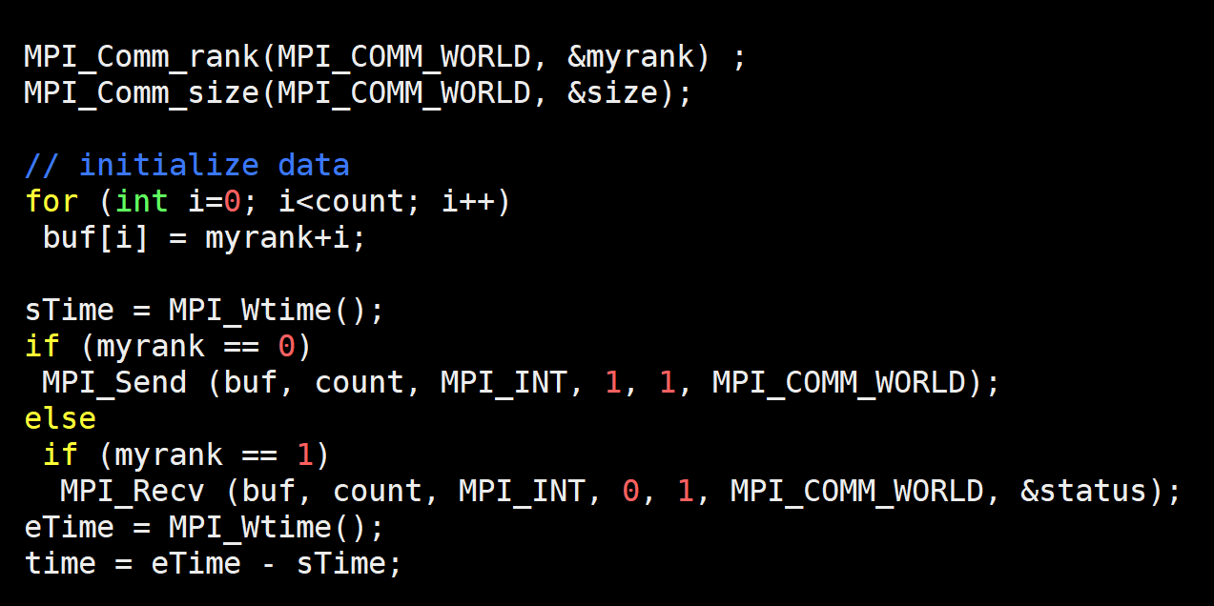
Timing Send/Recv (timingSend.c)

Slide 24
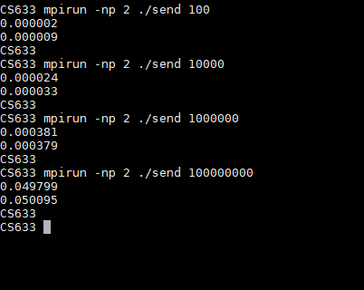
Timing Output
What is the total time?

Slide 25
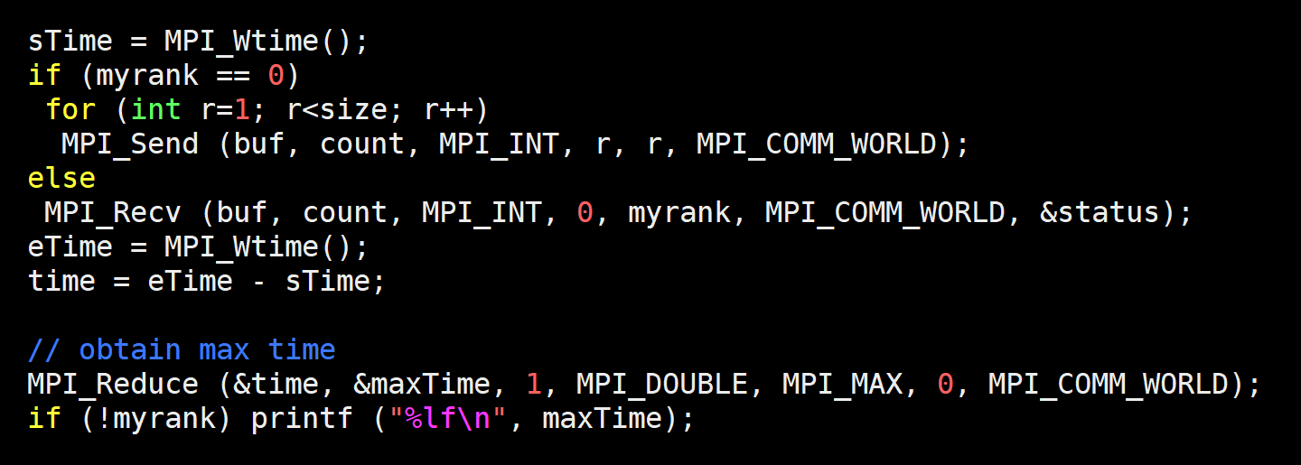
One-to-many Sends

Slide 26
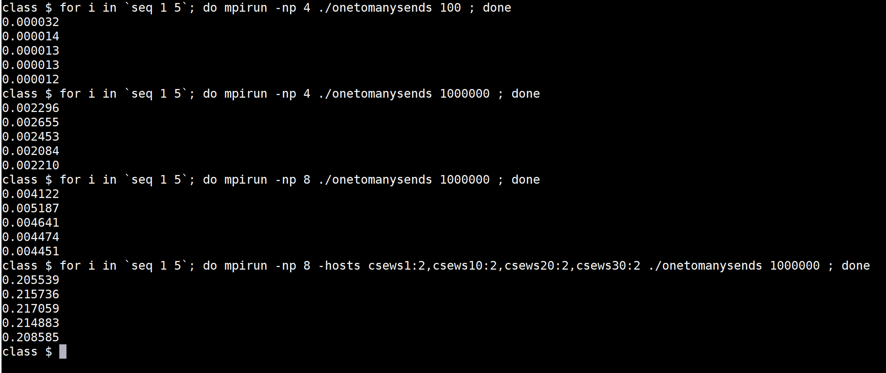
Output
Variability

Slide 27
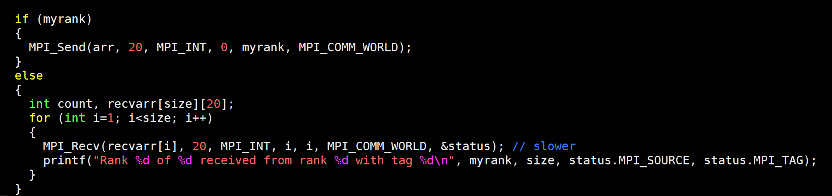
Many-to-one Sends
a send operation must specify a unique receiver
MPI_Send (Blocking send)
MPI_Recv (Blocking receive)
Notes:
The status argument also returns information on the length of the message received. However, this information is not directly available as a field of the status variable and a call to MPI_GET_COUNT is required to ``decode'' this information.

Slide 28
MPI_ANY_*
int MPI_Recv (void *buf, int count, MPI_Datatype datatype, int source, int tag, MPI_Comm comm, MPI_Status *status)
MPI_ANY_SOURCE
  Receiver may specify wildcard value for source
MPI_ANY_TAG
  Receiver may specify wildcard value for tag

Slide 29
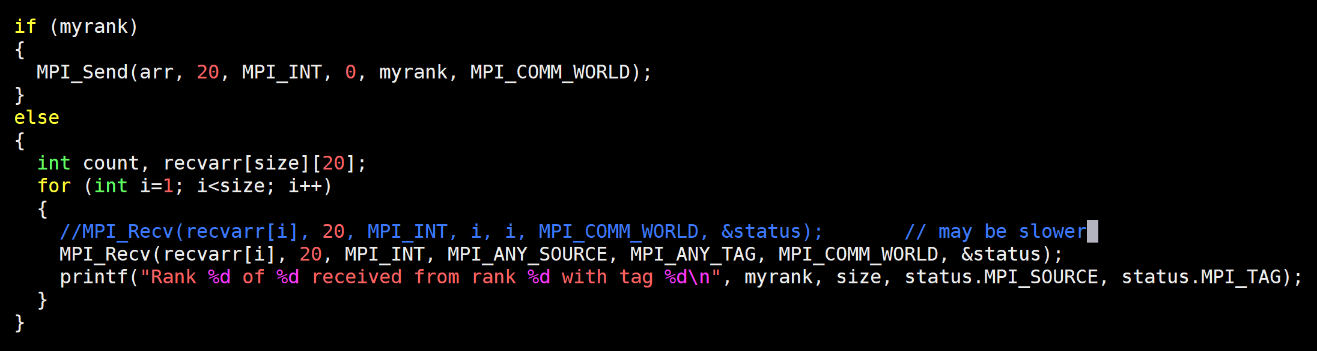
Receive Out-of-order
No specific order
Rectify the receive buffer location
Notes:
The status argument also returns information on the length of the message received. However, this information is not directly available as a field of the status variable and a call to MPI_GET_COUNT is required to ``decode'' this information.

Slide 30
Sum of Squares of N numbers
Serial
for i = 1 to N
sum += a[i] * a[i]
Parallel
for i = 1 to N/P
sum += a[i] * a[i]
collate result
P

Slide 31
Sum of Squares
Core
Process
Memory
for i = 1 to N/P
sum += a[i] * a[i]
for i = 1 to N/P
sum += a[i] * a[i]
for i = 1 to N/P
sum += a[i] * a[i]
for i = 1 to N/P
sum += a[i] * a[i]
Rank = 0 Rank = 1 Rank = 2 Rank = 3
Notes:
How does OS launch processes?

Slide 32
SIMD Parallelism
for i = N/P * rank ; i < N/P * (rank+1) ; i++
localsum += a[i] * a[i]
//Collect localsum, add up at one of the ranks
if (rank)
recv from all ranks (…)
else
send (0)

